Slide 1


OnShape Workshop
By Engineering Club

Slide 2
What is OnShape and CAD?
CAD
CAD = Computer Aided Design
Using any CAD program ( like OnShape, SolidWorks, Fusion360, etc.) you can create 3D objects that are parametric Very useful for engineering!
Paramentic - models are create/defined by parameters, relationships and constraints. (ex. Angles, length, height, other models)
OnShape
Its a Cloud Based CAD Software.
It runs on many computers through a browser.

Slide 3
CAD Workflow
Make a 2D-Sketch.
Extrude the Sketch
Creates a 3D object
(extrude mean to push out)
Modify the object With features

Slide 4
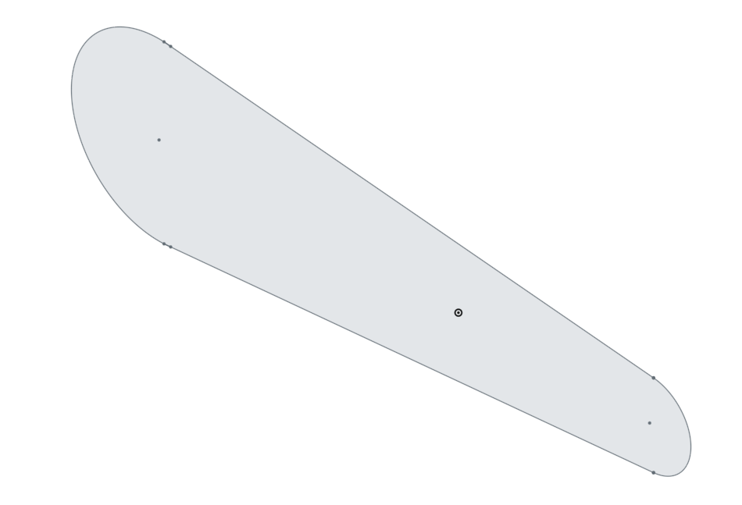
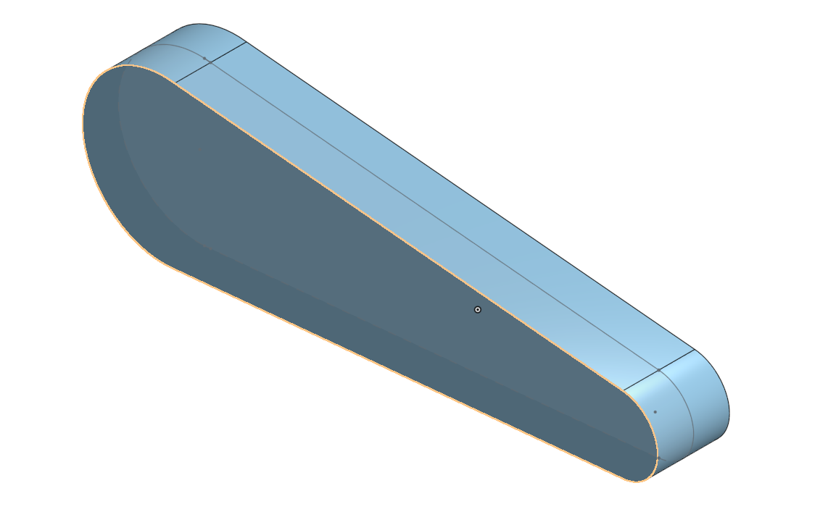

2D Sketch
3D Object
Extrude
sketch
Notes:
The work flow

Slide 5
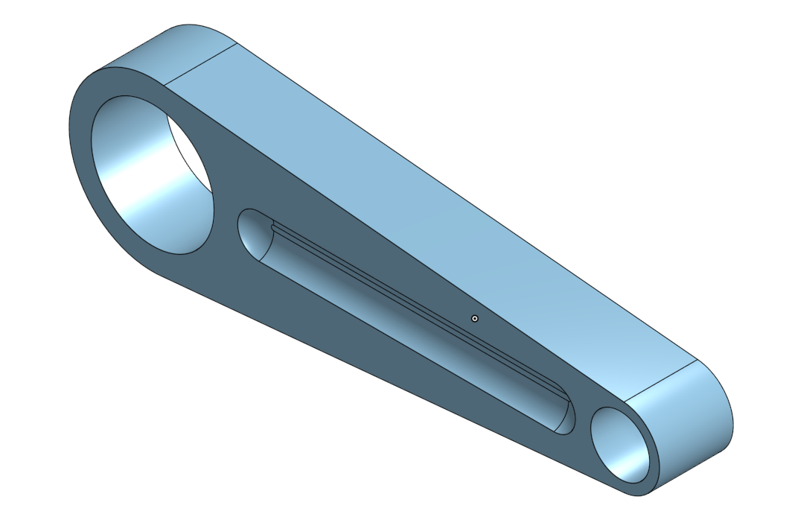
3D Object
3D Object With Features
Add Features

Slide 6

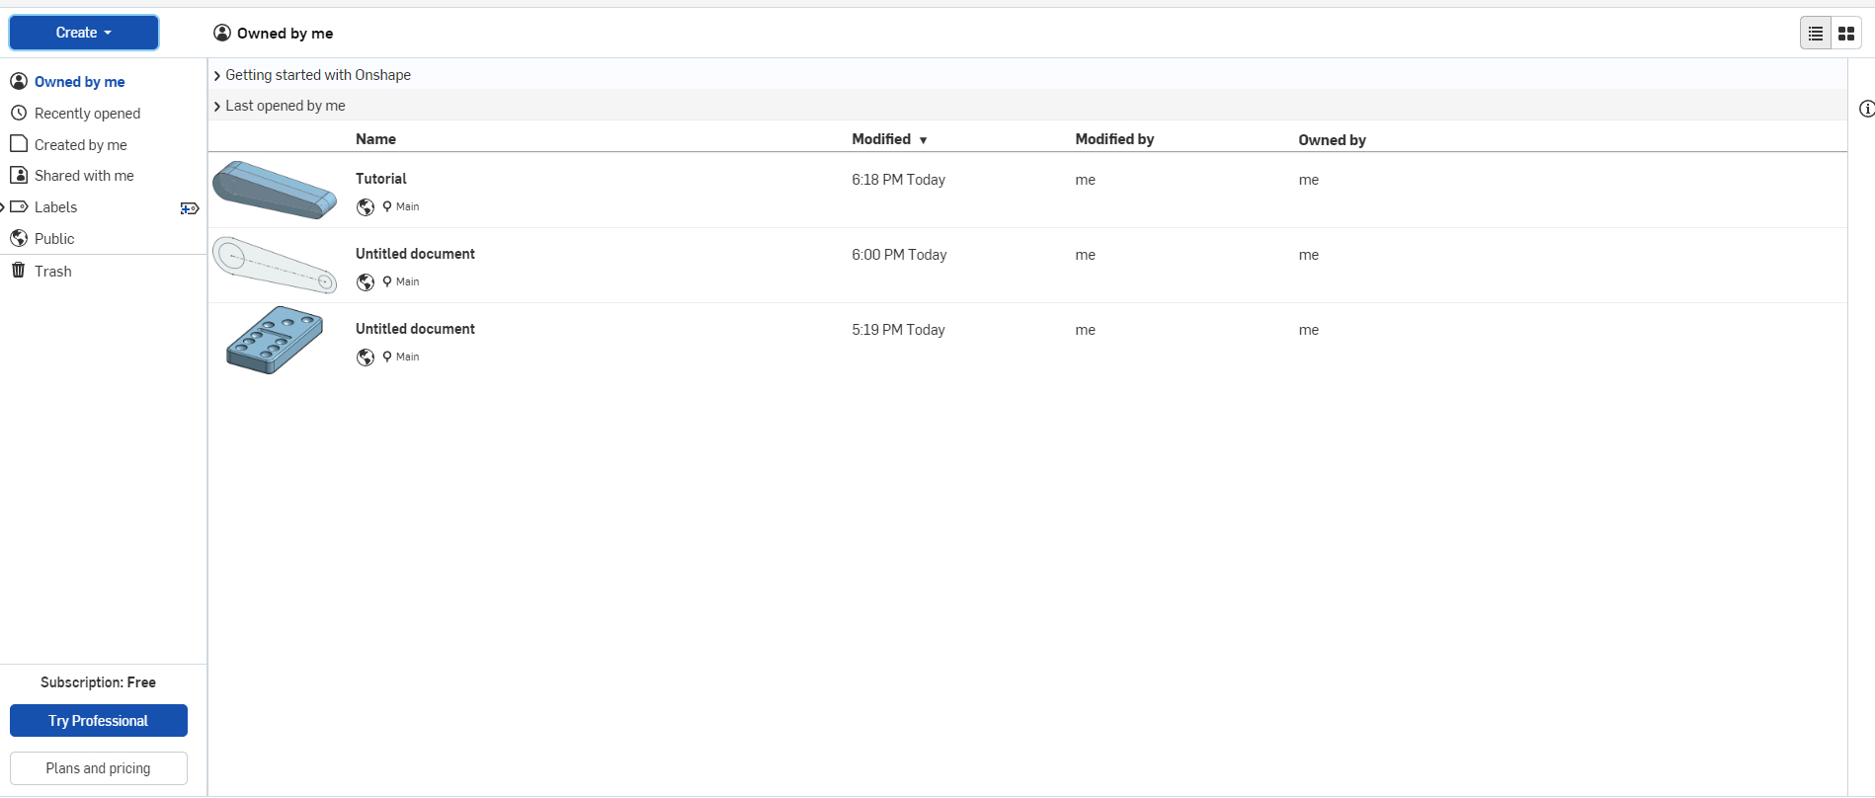
Create a document

Slide 7
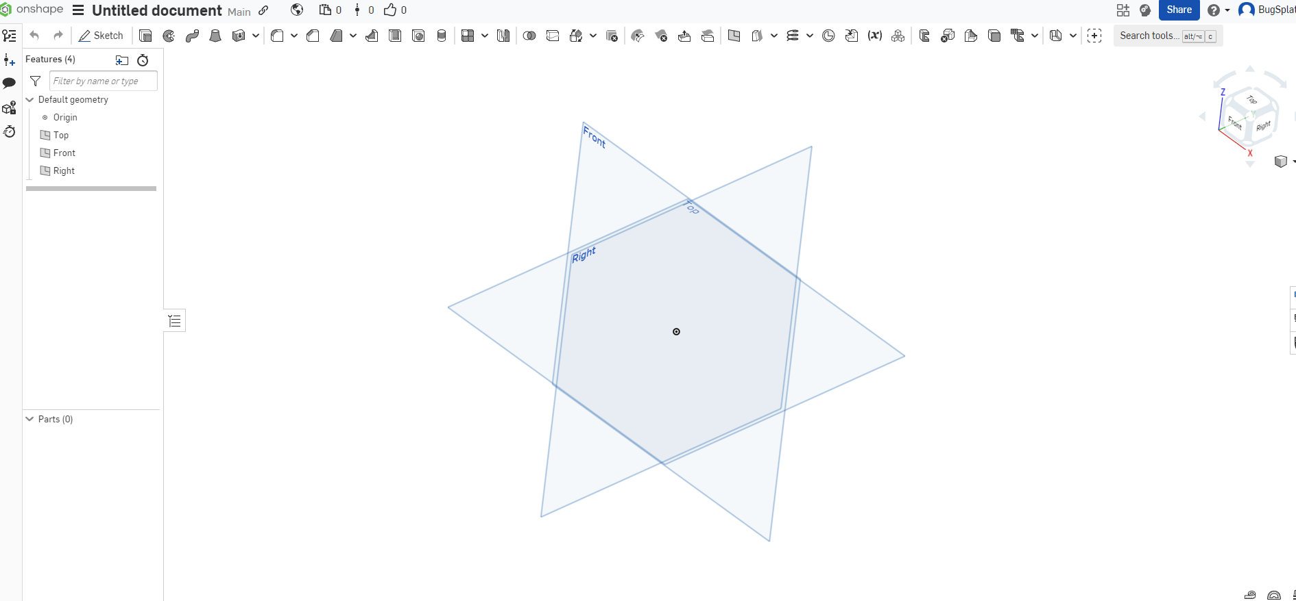
Basic Navigation
Rotate view with right mouse
Move view with middle mouse
You can also change your view using the view cube
You can also return to the default view called isometric through right click

Slide 8
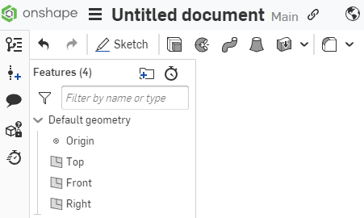
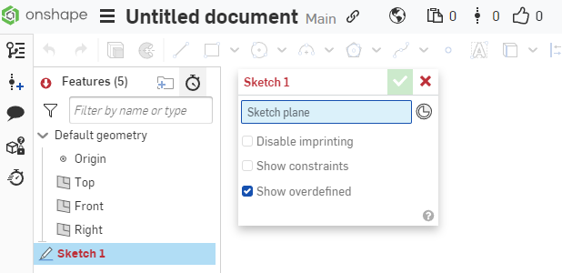
Start your first sketch
Click sketch in the top left of the page
Select the plane you wish to sketch on
In our case select the Top plane

Slide 9
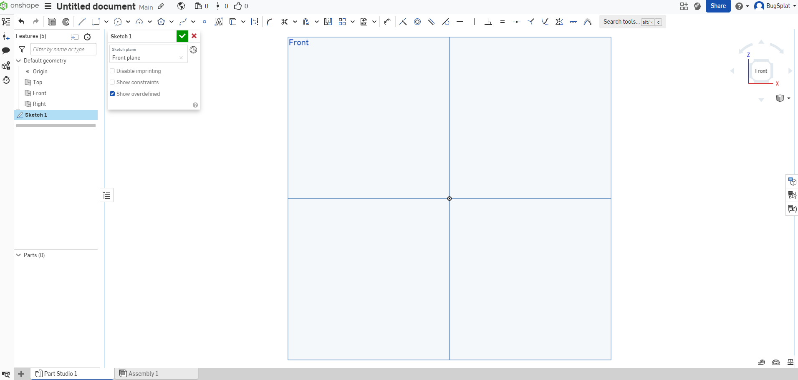
Orient yourself to the correct view
Click front on the view cube to face the camera to the front plane
Notes:
If you look at the bar of icons at the top of the page. Select the circle. Then place two circles on the centerline. Making sure to see the yellow dotted line.
Point out how the blue means it is not constrained. Thus you are able to move it with your mouse.
Click the rim of each circle. Now you've selected them. The number beside your mouse point tells you how many things you have selected as well as the highlight..

Slide 10

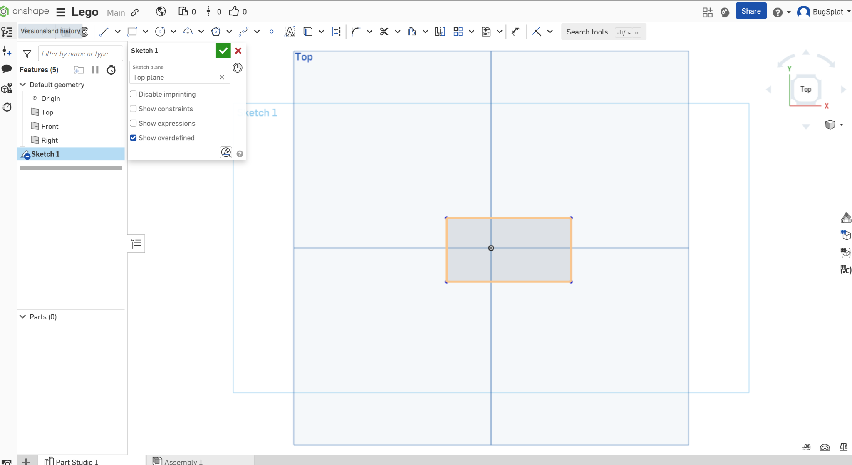
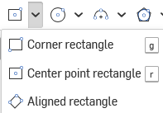




Basic Tools in Sketch
Line
Rectangle (But for this workshop, we’ll use the center rectangle.
Circle (Which is Center Point by Default)
Dimension tool (D shortcut)
Constraints (coincident, Parallel, Equal, ect.)
Offset Entities
Location:

Slide 11

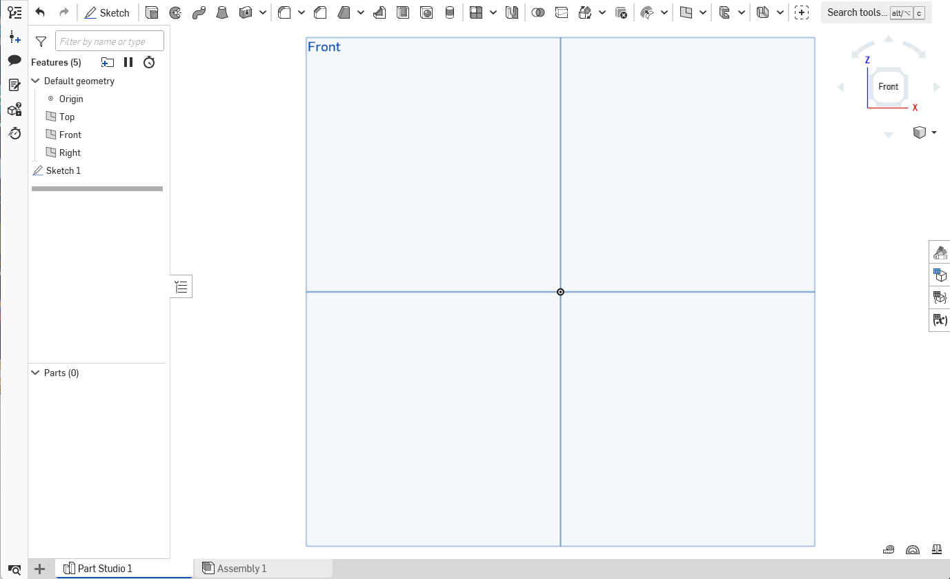



Basic Tools For 3D
Extrude (Add)
Extrude (Remove)
Measure
Mass Properties
Location:

Slide 12
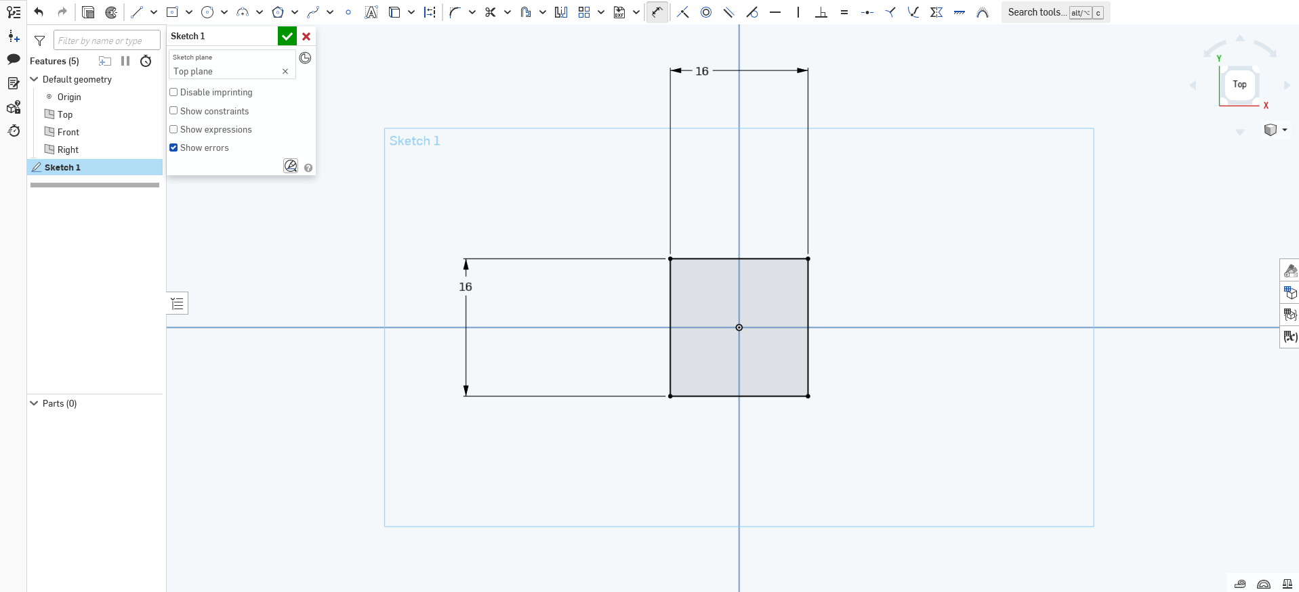
Create Rectangle with Dimensions 16mm on each side.
Once you are done Click the green check mark to confirm your sketch

Slide 13
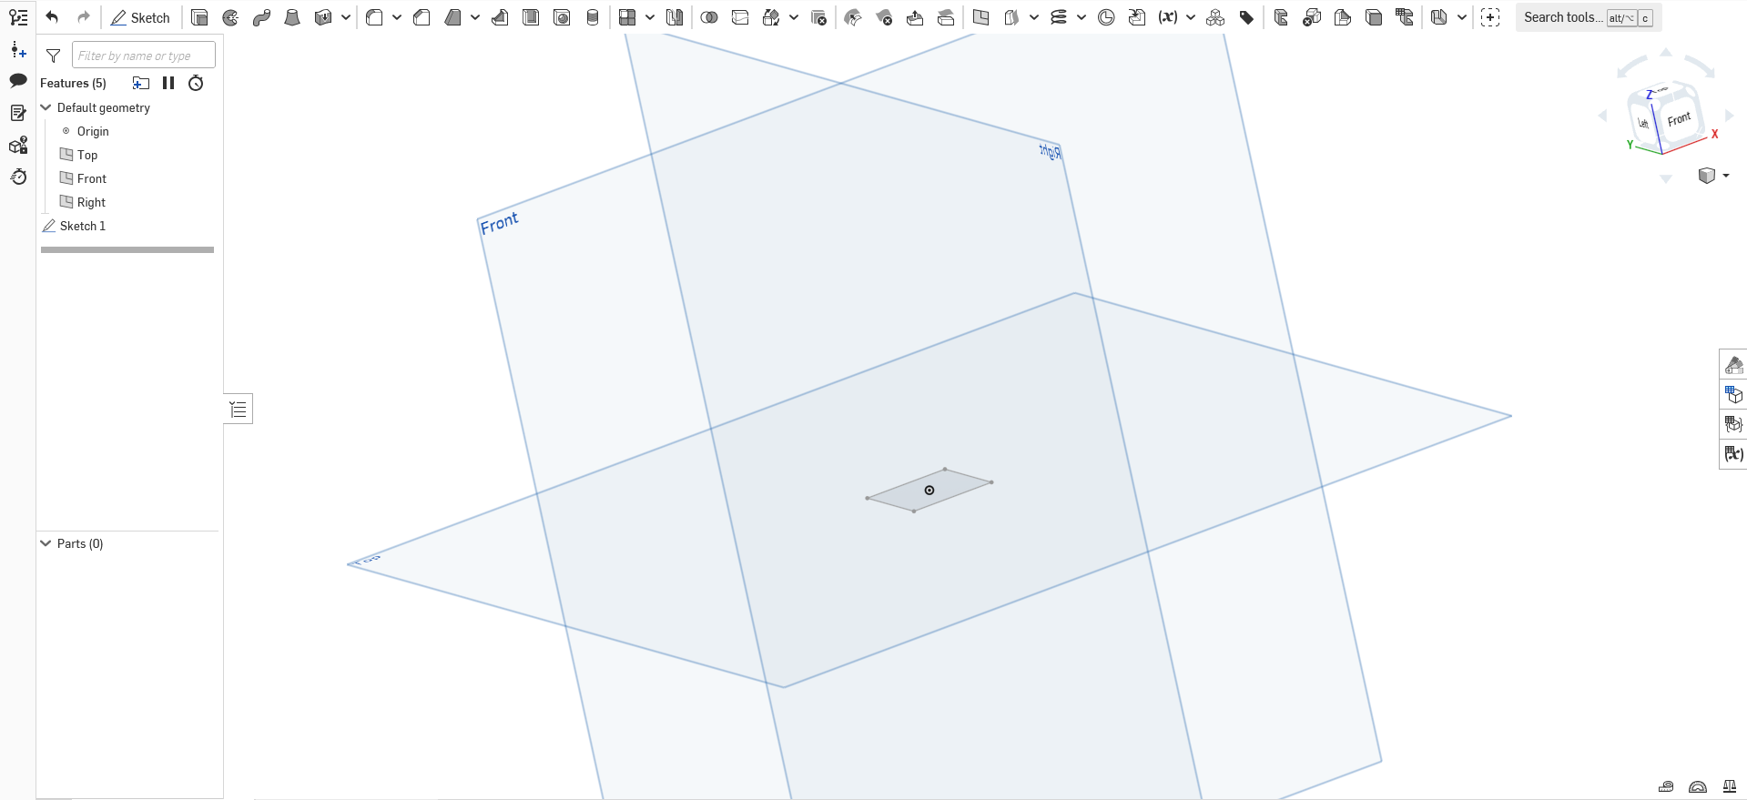

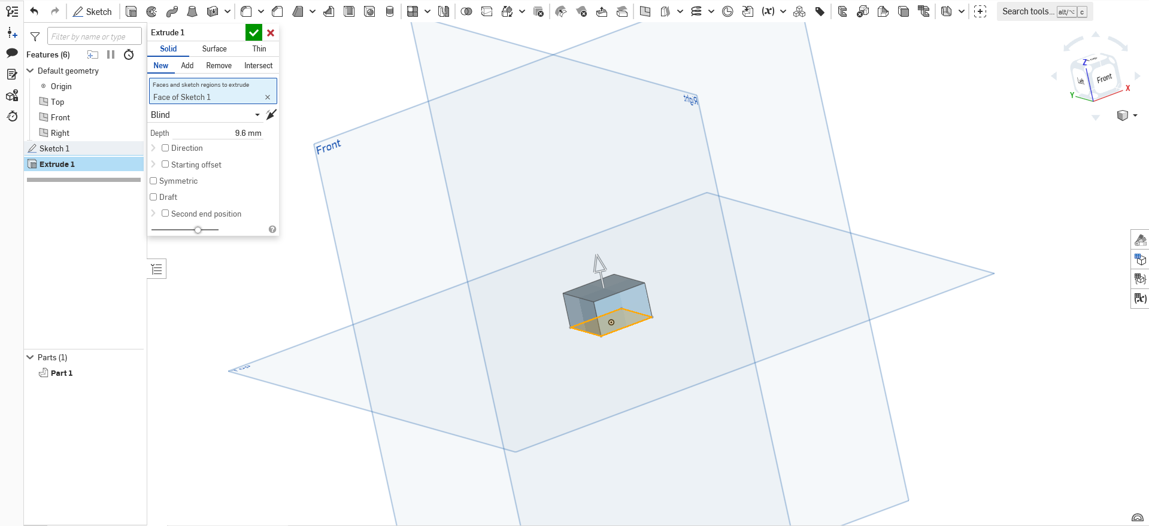
Now We Extrude
Extrude
Select the Extrude Button then click the sketch we created
Ensure it is set to “Add”
Set the depth of the extrusion to 9.6 mm

Slide 14
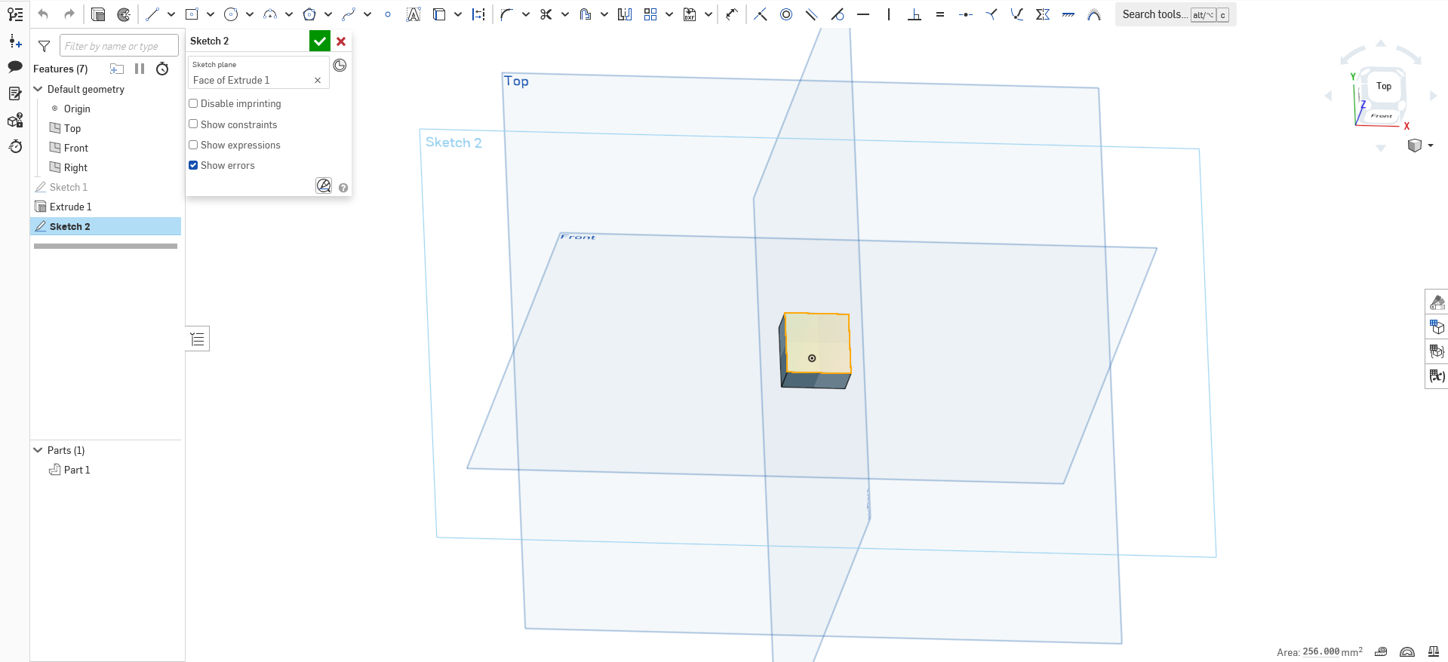
Select the top face and press “Sketch” again.

Slide 15
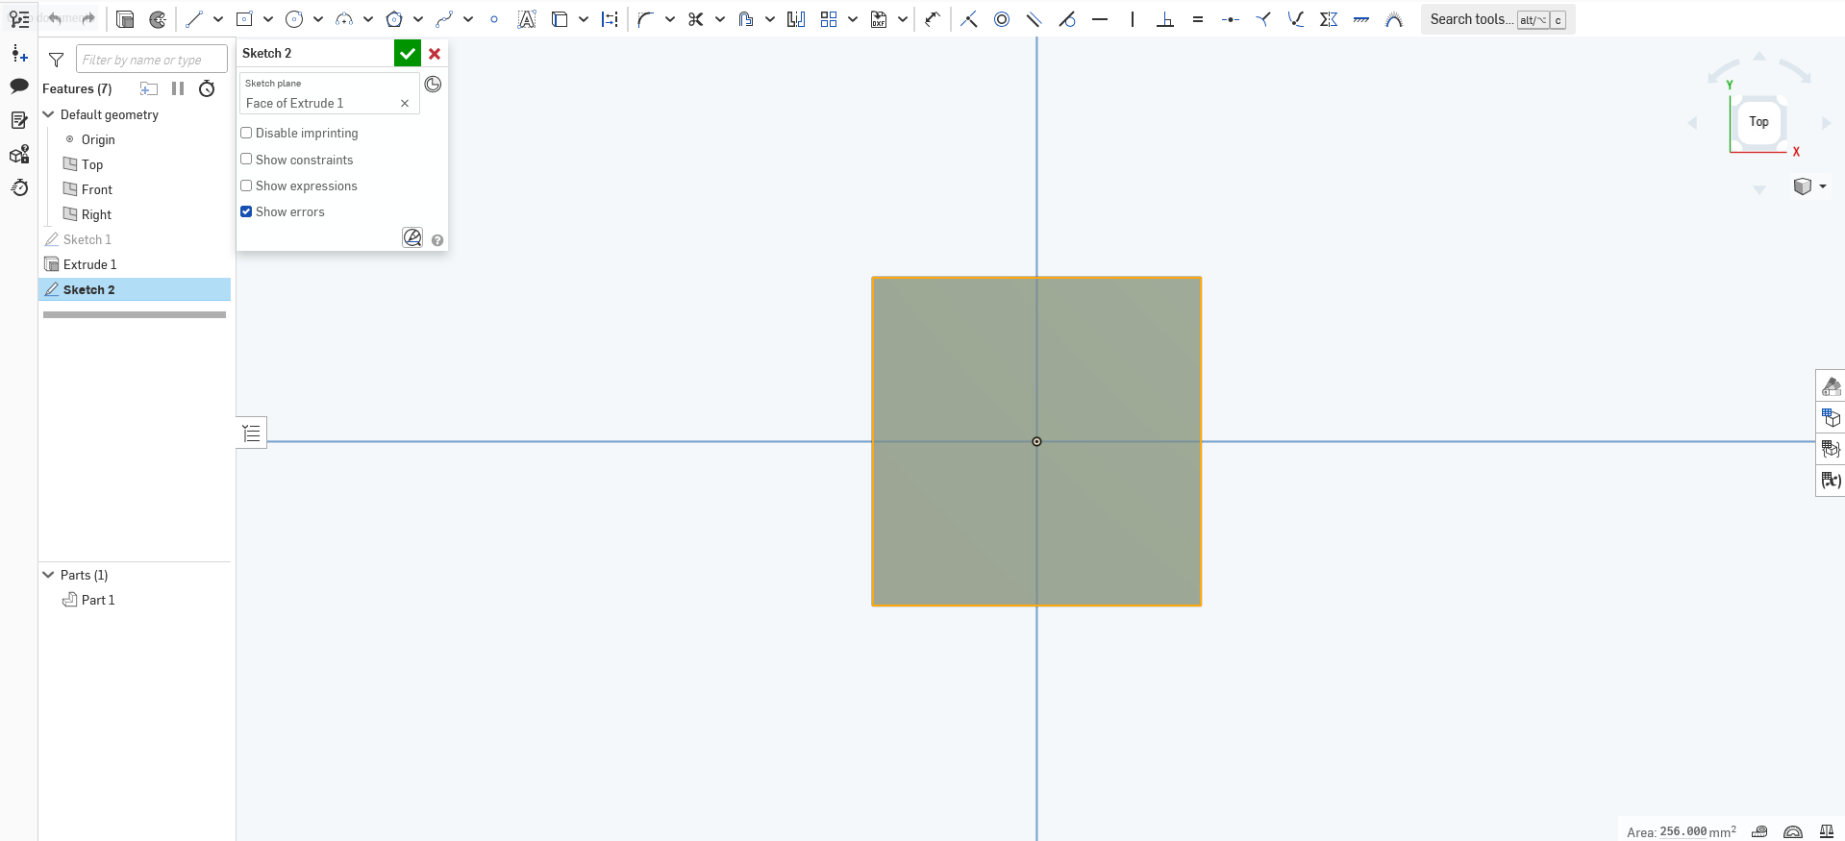
Press “Top” on the small cube navigator and zoom in.

Slide 16
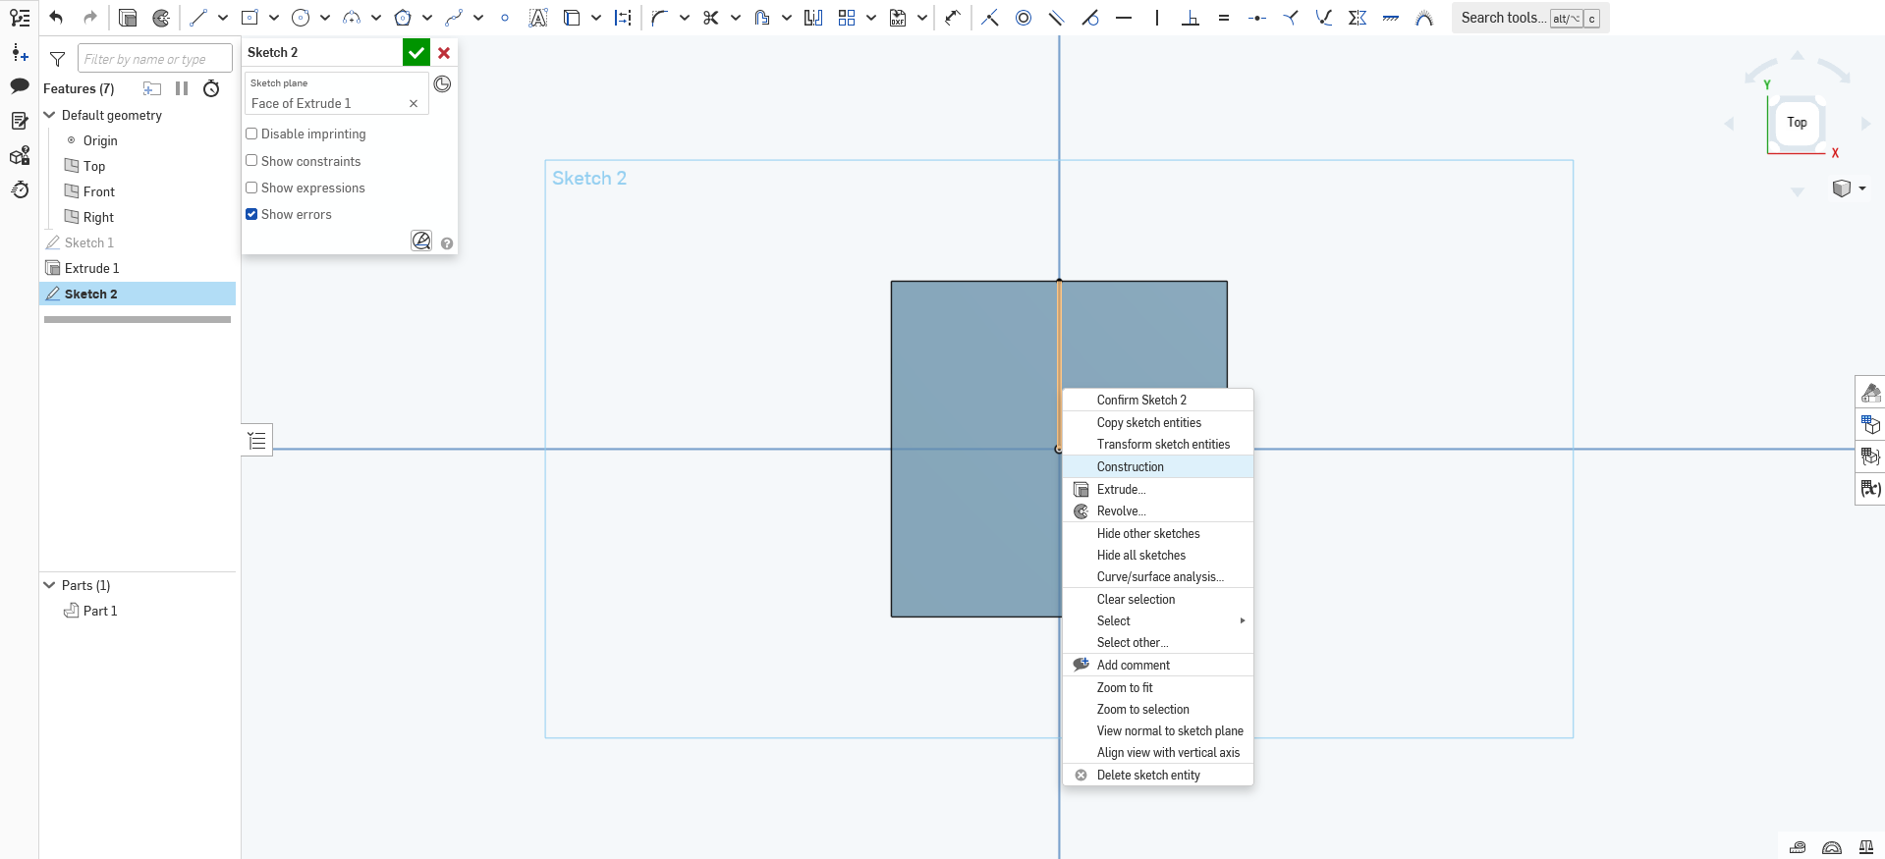
Create a construction line as such, by making a regular line, and right clicking it to press “Construction”

Slide 17
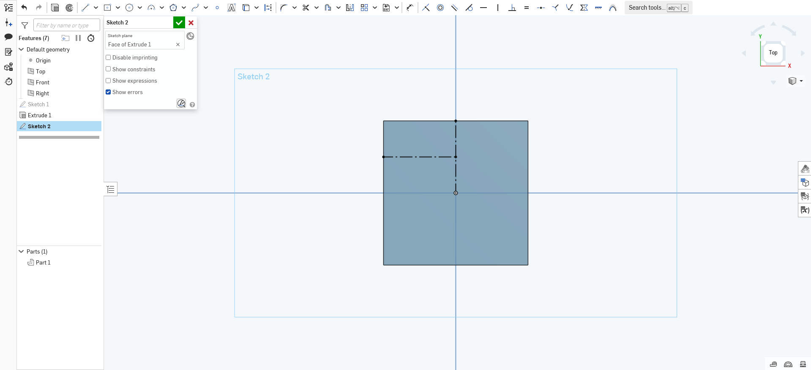
Add another construction line to help find the center of a quadrant
When hovering over the first line, hover over the midpoint and a “phantom point” will show up, allowing you to find the midpoint quickly.

Slide 18
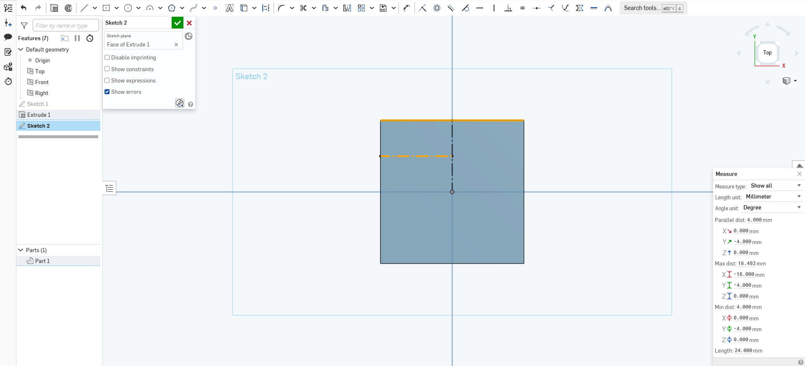
Use the “Measure” tool to ensure that your second construction line is 4mm to the outer wall of the large square right above it.

Slide 19
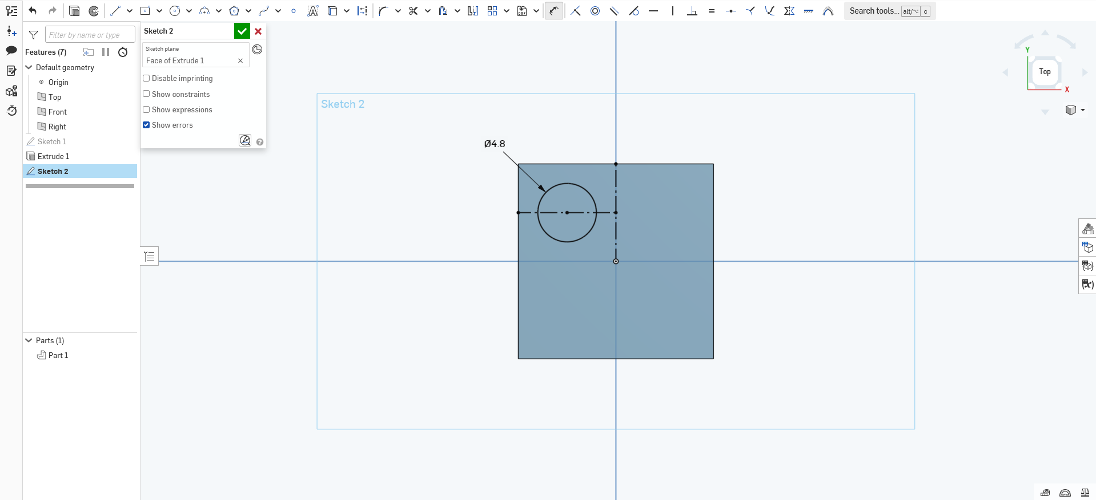
Using the midpoint of a line trick, create a center point circle on the midpoint of the second construction line and dimension it to be 4.8mm in diameter.

Slide 20

Next, using the circular pattern, click on the circle itself (not inside of it) and it should show 2 phantom circles centered around the origin. Change the number “3” to “4”. Then left click to save.

Slide 21
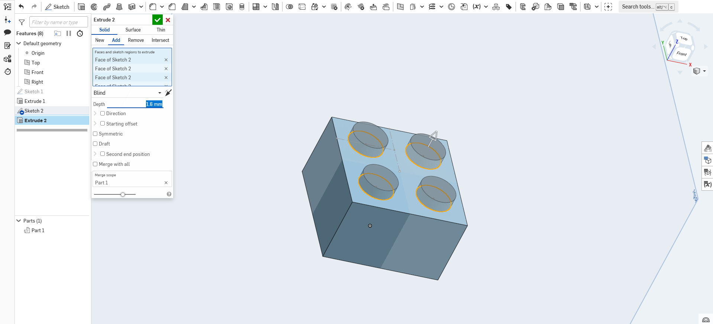
Shift and click all four circles made, then press the extrude button, ensure the setting is on “Add” and then set the depth to 1.6mm.

Slide 22
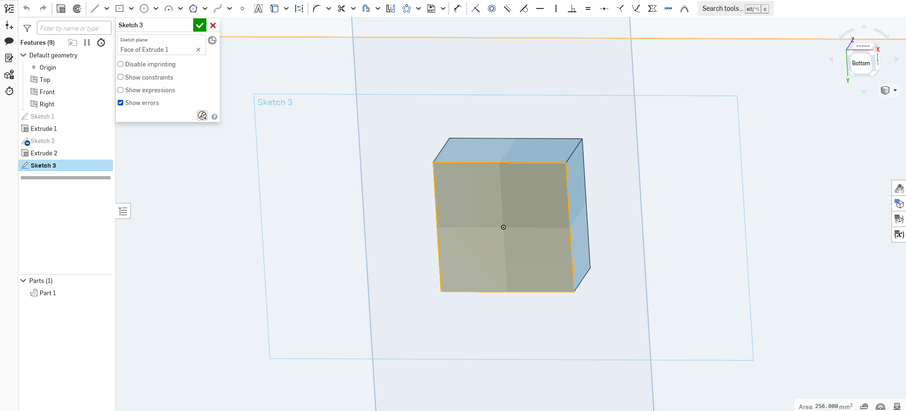
Then, flip over the model, click the bottom face, and press sketch. Use the cube navigation in the top right corner to focus on it and then zoom in.

Slide 23
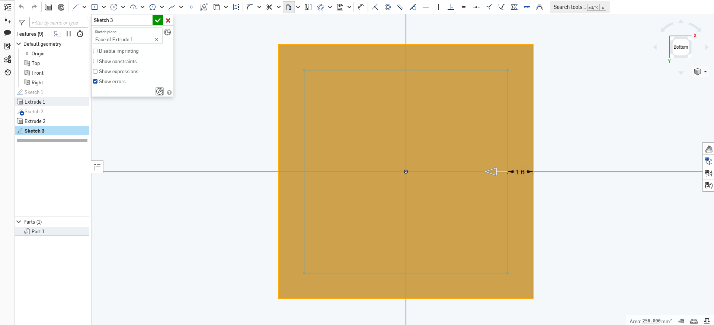
Press on the “Offset” button, then click on the bottom face again. You’ll get a large phantom square surrounding the face. Use the arrow (usually on the right side) and drag it in, so the offset is inside the size of the face. Then, set the number to 1.6mm and left click to save.

Slide 24
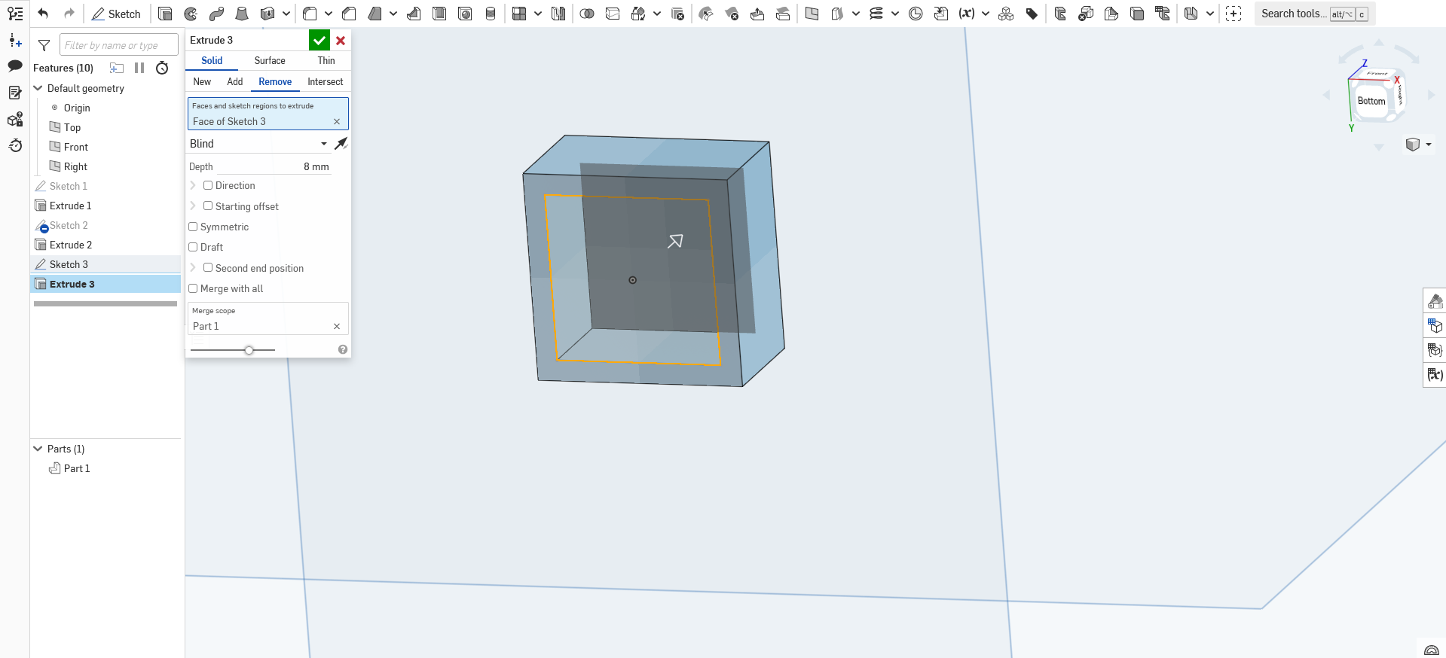
Click on this new square and press the “Extrude” button. Ensure it’s set to the “Remove” setting and make the depth 8mm

Slide 25
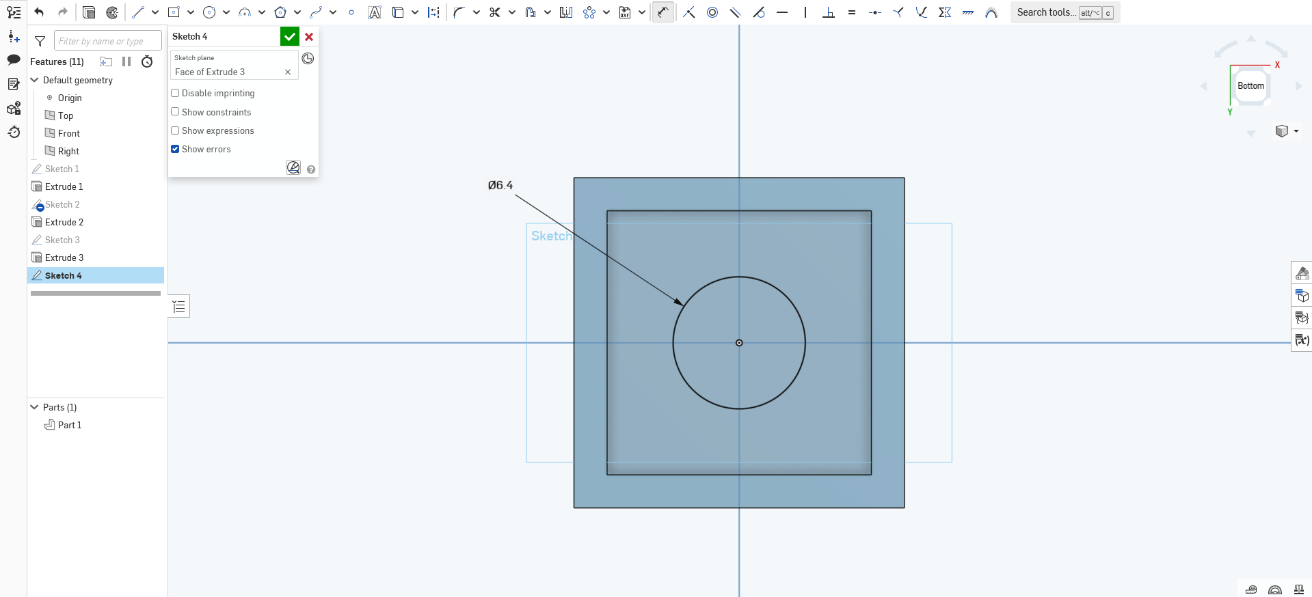
Now, click on the bottom face inside of the object, click on “Sketch” and then create a center circle in the middle with a diameter of 6.4mm

Slide 26
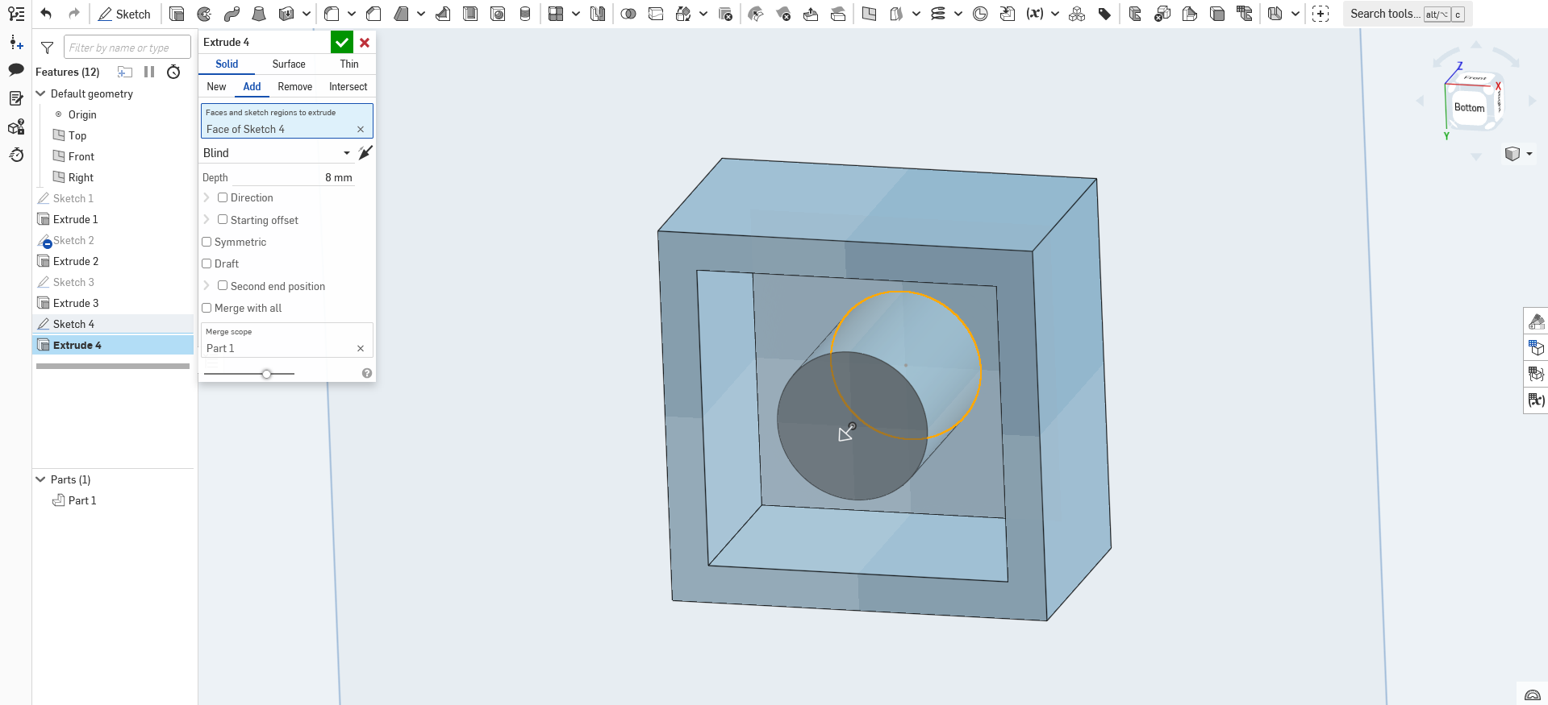
Then, Extrude this circle out by 8mm, to become flush with the walls of the brick.

Slide 27
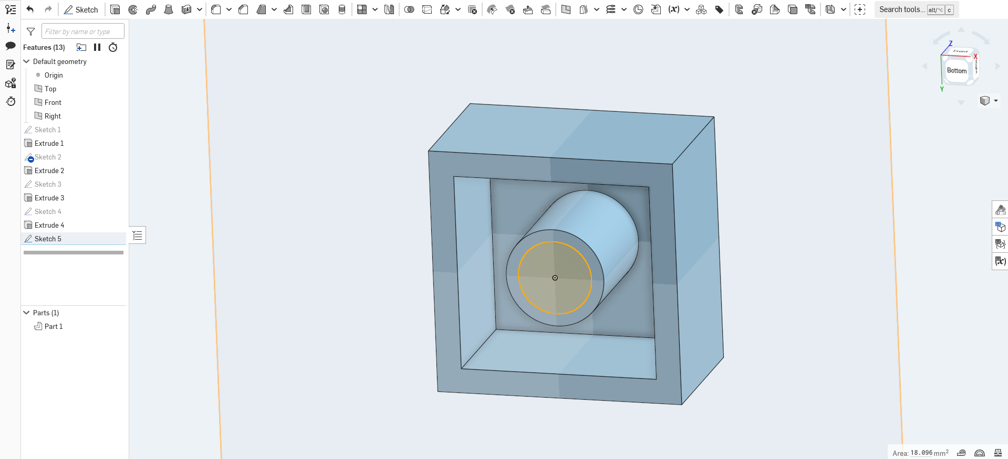
Then, click the center of the end of this extrusion and make a center circle 4.8mm in diameter.

Slide 28
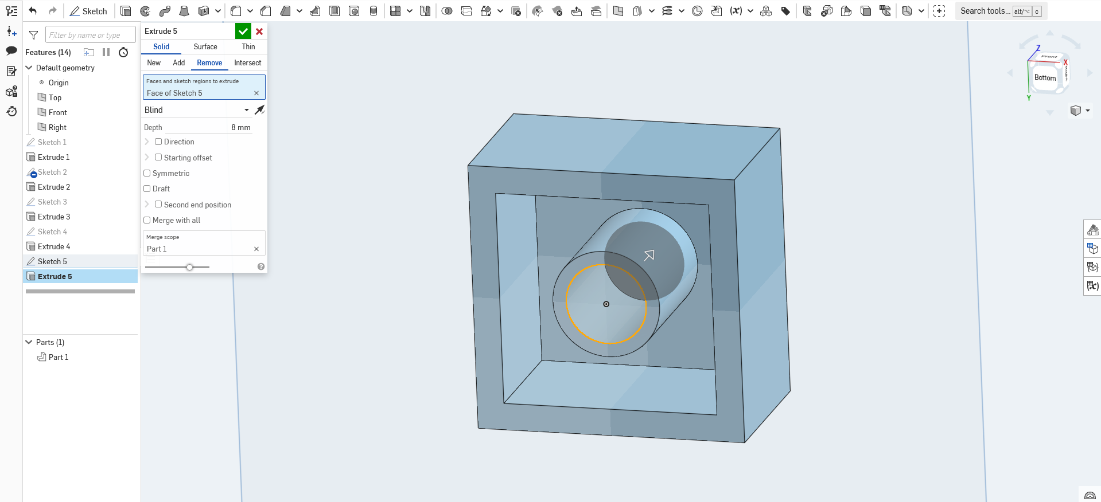
And finally, click on “Extrude,” set the setting to “Remove” and set the depth to 8mm.

Slide 29
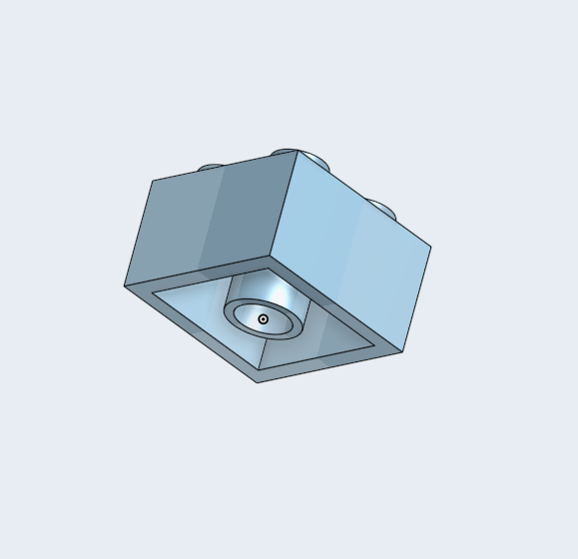
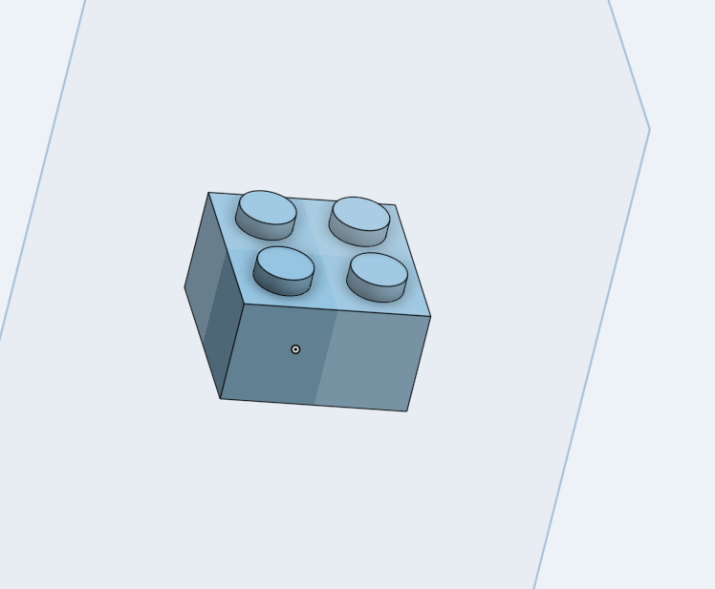
And there you have it, a 2x2 lego brick!

Slide 30
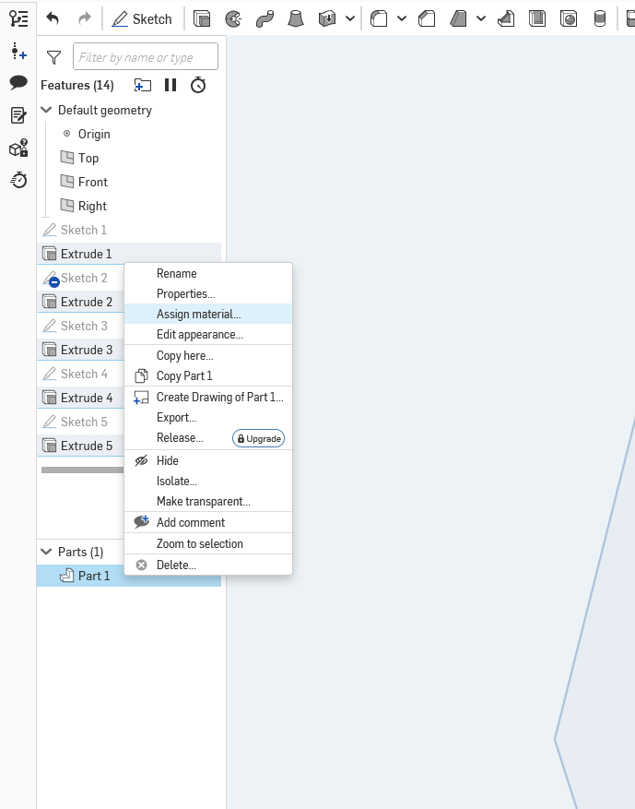
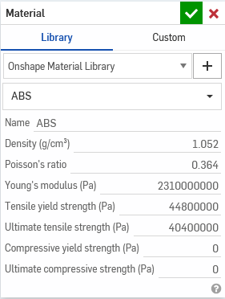
Now, for information about the model, go to the bottom left and right click on your part. Press “Assign material…” and find “ABS” as that’s what Lego has used for its bricks since 1963.

Slide 31
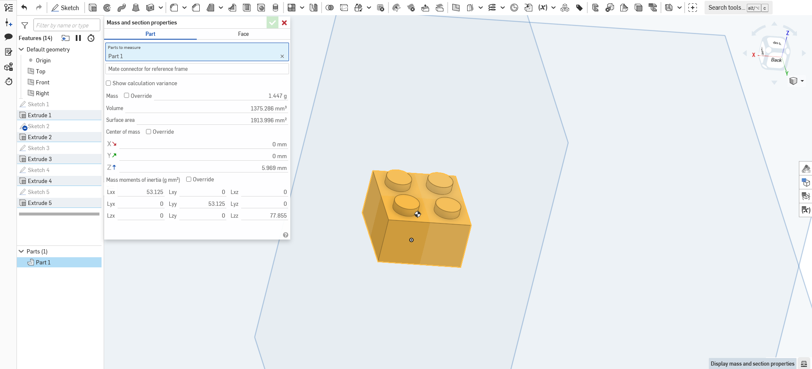
Then, click on the “Display Mass and Section Properties” button in the bottom right corner to display information about the model such as mass, volume, and center of mass.

Slide 32
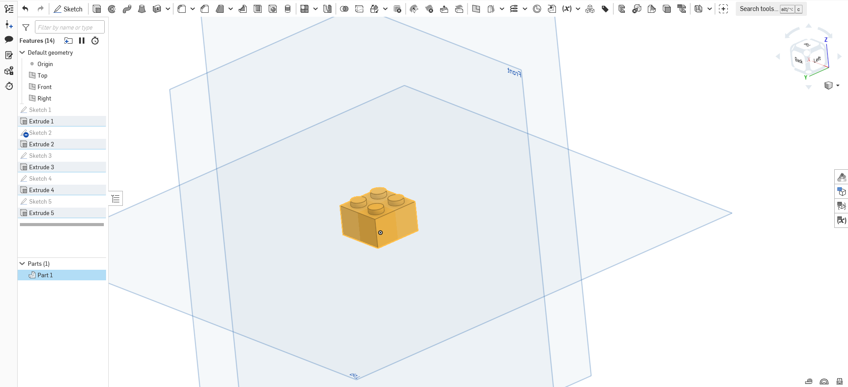
Congratulations! You’ve learned the basics of modeling on OnShape! Happy CAD-ing!

